Slide 1
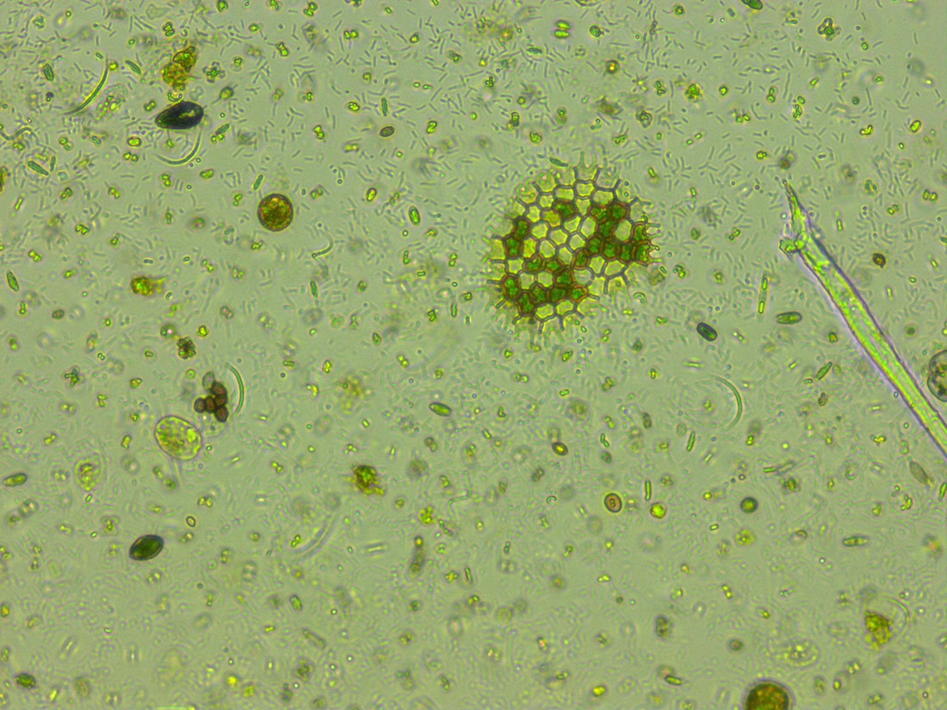
Predicting phytoplankton metabolism from the individual size distribution
Daniel Padfield

Slide 2
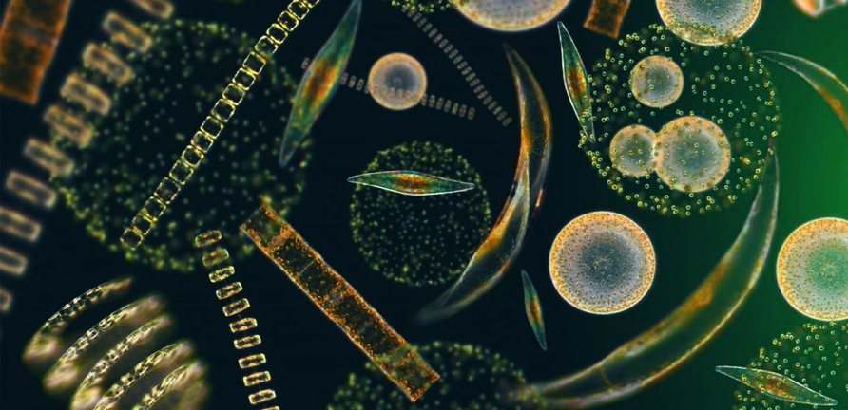
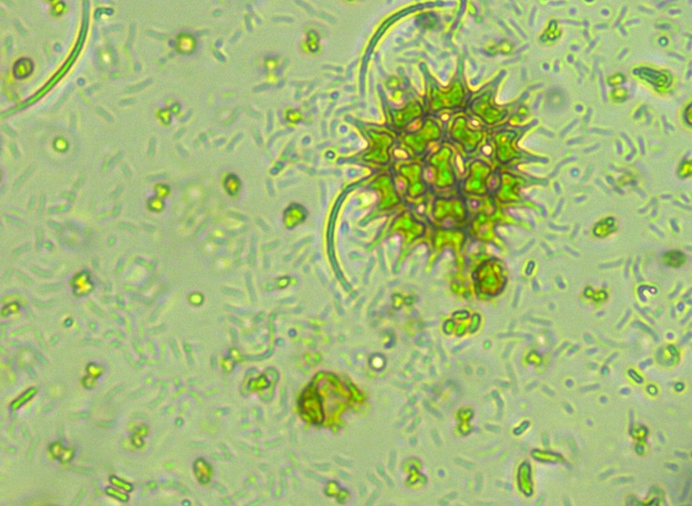
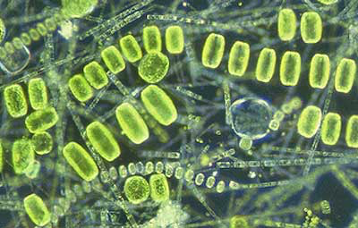
Phytoplankton are key for the carbon cycle
~50% of annual carbon fixation
Fuel entire ocean food webs

Slide 3
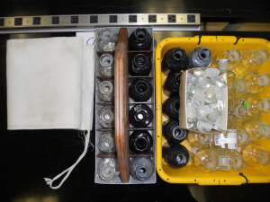
Current measurements of metabolism
Bottle incubations – in vivo
Snapshot in time
Single community
Control over environmental variables

Slide 4
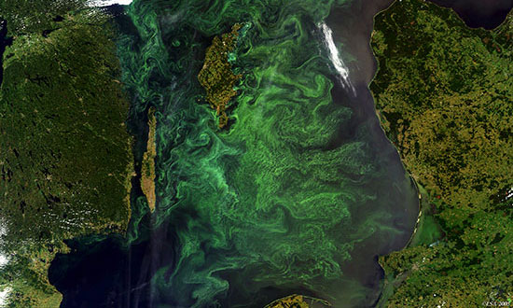
Current measurements of metabolism
Bottle incubations – in vivo
Gas measurements – in situ
Snapshot in time
Single community
Control over environmental variables
Integrates over large areas
Many communities and many different environmental conditions

Slide 5

Current measurements of metabolism
Bottle incubations – in vivo
Gas measurements – in situ
Most of the open ocean is net heterotrophic
Most of the open ocean is net autotrophic

Slide 6

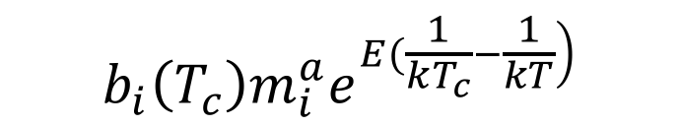
Crash course in metabolic theory
$$b_{i}\left(T_{c}\right)m_{i}^{a}e^{\left.E(\frac{1}{kT_{c}}−\frac{1}{kT}\right)}$$

Slide 7

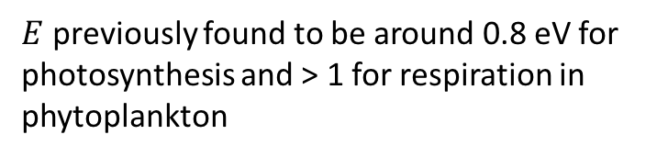
Crash course in metabolic theory
🔥🔥🔥🔥🔥🔥🔥
$$e^{\left.E(\frac{1}{kT_{c}}−\frac{1}{kT}\right)}$$
$E$ previously found to be around 0.8 eV for photosynthesis and > 1 for respiration in phytoplankton

Slide 8
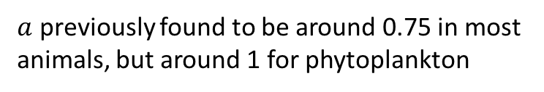

Crash course in metabolic theory
$$m_{i}^{a}$$
$a$ previously found to be around 0.75 in most animals, but around 1 for phytoplankton

Slide 9
Crash course in metabolic theory
$$m_{i}^{a}$$
$a$ previously found to be around 0.75 in most animals, but around 1 for phytoplankton

Slide 10
Crash course in metabolic theory
🔥🔥🔥🔥🔥🔥🔥
🔥🔥🔥🔥🔥🔥🔥
$$b_{i}\left(T_{c}\right)m_{i}^{a}e^{\left.E(\frac{1}{kT_{c}}−\frac{1}{kT}\right)}$$

Slide 11
Crash course in metabolic theory
🔥🔥🔥🔥🔥🔥🔥
$$b_{i}\left(T_{c}\right)m_{i}^{a}e^{\left.E(\frac{1}{kT_{c}}−\frac{1}{kT}\right)}$$

Slide 12
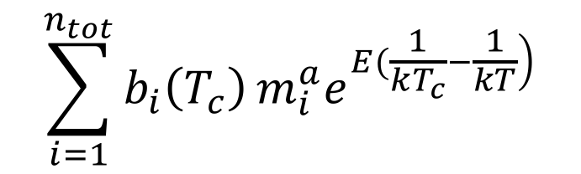
Crash course in metabolic theory
🔥🔥🔥🔥🔥🔥🔥
$$\sum_{i=1}^{n_{tot}}{b_{i}\left(T_{c}\right)}m_{i}^{a}e^{\left.E(\frac{1}{kT_{c}}−\frac{1}{kT}\right)}$$
🔥🔥🔥

Slide 13
Crash course in metabolic theory
🔥🔥🔥🔥🔥
🔥🔥
🔥🔥🔥🔥🔥🔥🔥
$$\sum_{i=1}^{n_{tot}}{b_{i}\left(T_{c}\right)}m_{i}^{a}e^{\left.E(\frac{1}{kT_{c}}−\frac{1}{kT}\right)}$$
🔥🔥🔥
🔥🔥

Slide 14
Crash course in metabolic theory
🔥🔥🔥🔥🔥
🔥🔥
🔥
🔥🔥🔥🔥🔥🔥🔥
🔥🔥🔥🔥🔥🔥🔥🔥
$$\sum_{i=1}^{n_{tot}}{b_{i}\left(T_{c}\right)}m_{i}^{a}e^{\left.E(\frac{1}{kT_{c}}−\frac{1}{kT}\right)}$$
🔥🔥🔥
🔥🔥

Slide 15
Zero-sum dynamics

Slide 16
Uses of metabolic theory

Slide 17
Predictions

Slide 18
Experimental setup
10 years warming : half 4ºC above ambient

Slide 19

Experimental setup
How do the communities and their functioning change in response to long-term and short-term warming
10 years warming : half 4ºC above ambient
Cool incubator ~ 4 weeks
Warm incubator ~ 4 weeks

Slide 20
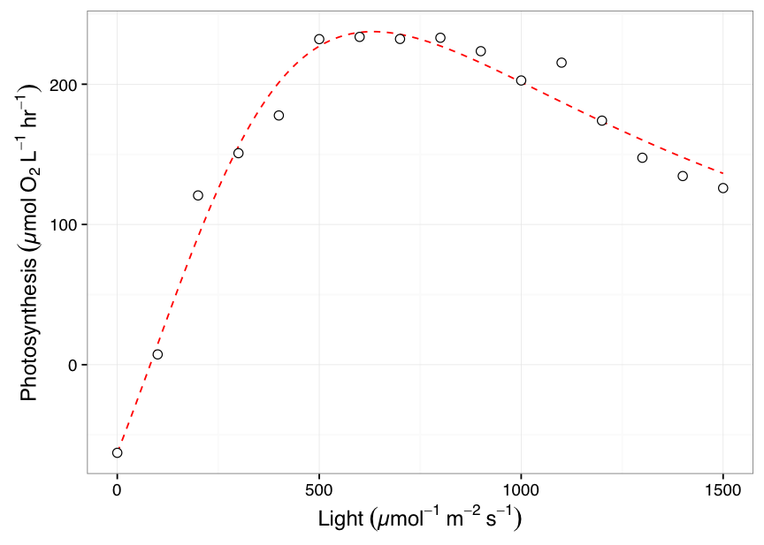
Measurements
+
Metabolism @ incubator temperature
1 point for each microcosm
Size distribution
> 300 points per sample!

Slide 21
Long-term warming changes communities

Slide 22
No difference in measured raw metabolism

Slide 23
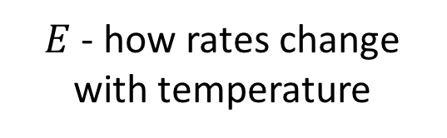
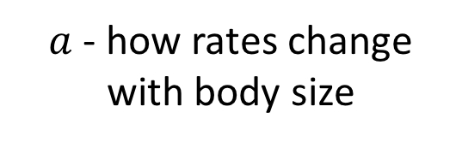
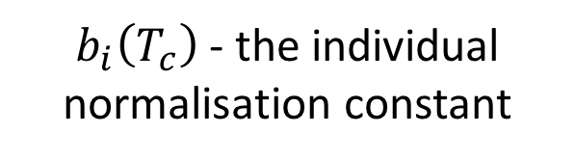
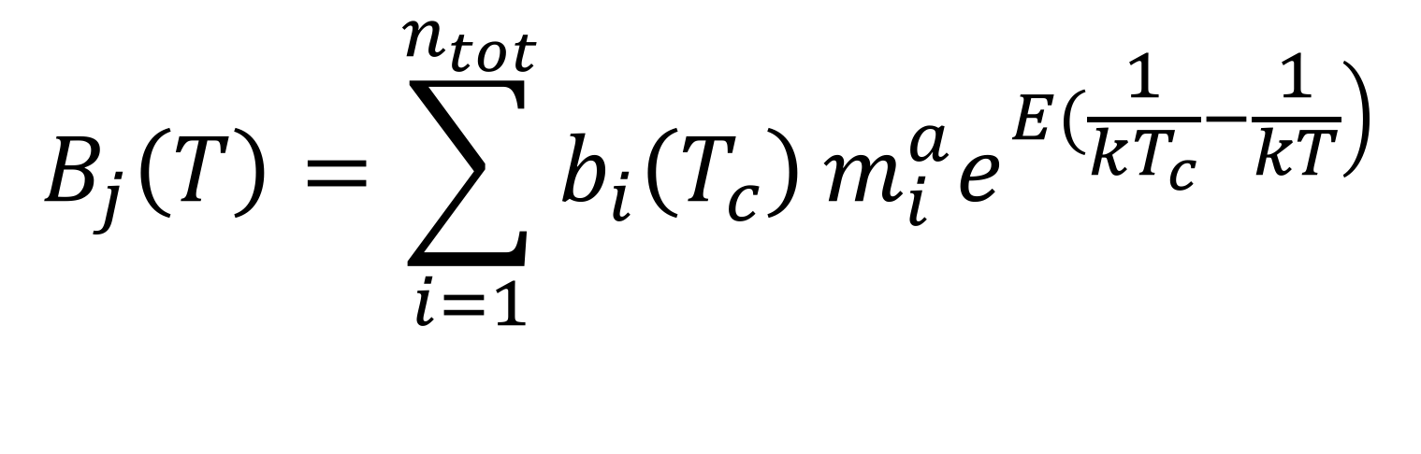
Model
$a$ - how rates change with body size
$$B_{j}\left(T\right)=\sum_{i=1}^{n_{tot}}{b_{i}\left(T_{c}\right)}m_{i}^{a}e^{\left.E(\frac{1}{kT_{c}}−\frac{1}{kT}\right)}$$
$b_{i}\left(T_{c}\right)$ - the individual normalisation constant
$E$ - how rates change with temperature

Slide 24
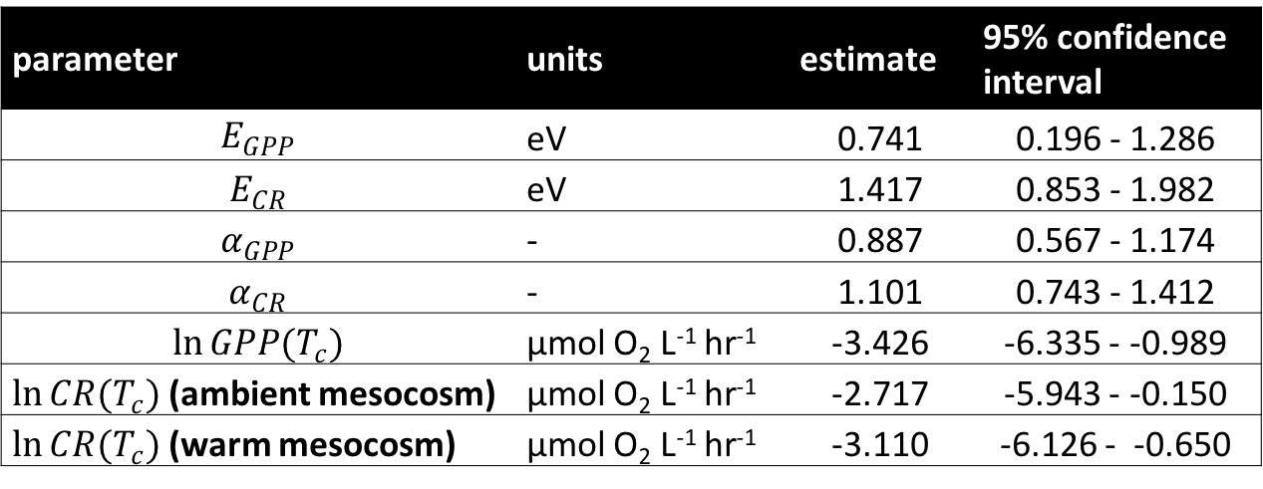
Model predicts size and temperature-dependence
parameter | units | estimate | 95% confidence interval
$$E_{GPP}$$ | eV | 0.741 | 0.196 - 1.286
$$E_{CR}$$ | eV | 1.417 | 0.853 - 1.982
$$α_{GPP}$$ | - | 0.887 | 0.567 - 1.174
$$α_{CR}$$ | - | 1.101 | 0.743 - 1.412
$$\ln{GPP(T_{c})}$$ | µmol O₂ L⁻¹ hr⁻¹ | -3.426 | -6.335 - -0.989
$\ln{CR(T_{c})}$ (ambient mesocosm) | µmol O₂ L⁻¹ hr⁻¹ | -2.717 | -5.943 - -0.150
$\ln{CR(T_{c})}$ (warm mesocosm) | µmol O₂ L⁻¹ hr⁻¹ | -3.110 | -6.126 - -0.650

Slide 25
Model predicts size and temperature-dependence
parameter | units | estimate | 95% confidence interval
$$E_{GPP}$$ | eV | 0.741 | 0.196 - 1.286
$$E_{CR}$$ | eV | 1.417 | 0.853 - 1.982
$$α_{GPP}$$ | - | 0.887 | 0.567 - 1.174
$$α_{CR}$$ | - | 1.101 | 0.743 - 1.412
$$\ln{GPP(T_{c})}$$ | µmol O₂ L⁻¹ hr⁻¹ | -3.426 | -6.335 - -0.989
$\ln{CR(T_{c})}$ (ambient mesocosm) | µmol O₂ L⁻¹ hr⁻¹ | -2.717 | -5.943 - -0.150
$\ln{CR(T_{c})}$ (warm mesocosm) | µmol O₂ L⁻¹ hr⁻¹ | -3.110 | -6.126 - -0.650

Slide 26
Model predicts size and temperature-dependence
parameter | units | estimate | 95% confidence interval
$$E_{GPP}$$ | eV | 0.741 | 0.196 - 1.286
$$E_{CR}$$ | eV | 1.417 | 0.853 - 1.982
$$α_{GPP}$$ | - | 0.887 | 0.567 - 1.174
$$α_{CR}$$ | - | 1.101 | 0.743 - 1.412
$$\ln{GPP(T_{c})}$$ | µmol O₂ L⁻¹ hr⁻¹ | -3.426 | -6.335 - -0.989
$\ln{CR(T_{c})}$ (ambient mesocosm) | µmol O₂ L⁻¹ hr⁻¹ | -2.717 | -5.943 - -0.150
$\ln{CR(T_{c})}$ (warm mesocosm) | µmol O₂ L⁻¹ hr⁻¹ | -3.110 | -6.126 - -0.650

Slide 27
Model predicts size and temperature-dependence
parameter | units | estimate | 95% confidence interval
$$E_{GPP}$$ | eV | 0.741 | 0.196 - 1.286
$$E_{CR}$$ | eV | 1.417 | 0.853 - 1.982
$$α_{GPP}$$ | - | 0.887 | 0.567 - 1.174
$$α_{CR}$$ | - | 1.101 | 0.743 - 1.412
$$\ln{GPP(T_{c})}$$ | µmol O₂ L⁻¹ hr⁻¹ | -3.426 | -6.335 - -0.989
$\ln{CR(T_{c})}$ (ambient mesocosm) | µmol O₂ L⁻¹ hr⁻¹ | -2.717 | -5.943 - -0.150
$\ln{CR(T_{c})}$ (warm mesocosm) | µmol O₂ L⁻¹ hr⁻¹ | -3.110 | -6.126 - -0.650

Slide 28
Model does a pretty good job!

Slide 29
Paradoxical result?

Slide 30
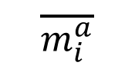
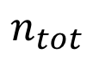
Zero-sum dynamics
$$\overline{m_{i}^{a}}$$
$$n_{tot}$$

Slide 31
Zero-sum dynamics
$$\overline{m_{i}^{a}}$$
$$n_{tot}$$
Slope = - 1.16 (95% CI: -1.58 - -0.86)
Not different from -1

Slide 32
Zero-sum dynamics
$$\overline{m_{i}^{a}}$$
$$n_{tot}$$
Slope = - 1.16 (95% CI: -1.58 - -0.86)
Not different from -1
Nutrient concentrations are going to be key for determining response to warming.

Slide 33
Conclusions
Empirically validated some key assumptions of metabolic theory and zero sum dynamics
Can potentially estimate metabolism purely from the size distribution of a plankton community!

Slide 34
Thanks for listening!

